Slide 1

KisanSevak
Sustainable Goal: 12
Project Mentor: Mrs. Yugchhaya Ghalphat
Group Number: 31
Group Members:
Shreerang Vaidya D7B 59
Jatin Navani D7B 34
Anjali Thakrani D7B 57
Samarth Nilkanth D7B 38

Slide 2
Content
Introduction
Problem Definition
Goals/ Objectives
Survey of Existing System
Limitation Existing system or research gap
Details of Hardware & Software
Proposed System: Introduction
Architecture/ Framework (Block Diagram, Conceptual Diagram, ER Diagram)
9. Algorithm and Process Design
10. Implementation details(GUI Screenshot, Dataset Used)
11. Results Obtained
12. Evaluation Measures
13. References

Slide 3
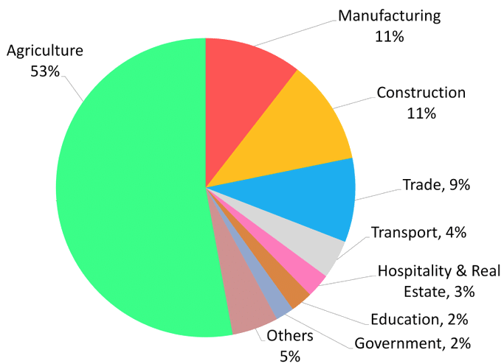
Introduction to Project
India is a major global agricultural producer of wheat, rice, cotton, milk, pulses, and spices.
Despite this, Indian farmers face various challenges, including socio-economic insecurity and chronic indebtedness.
It also focuses on introducing farmers to new technologies and best practices to improve crop production and market access.
Employment by Sector (%) 2009-10

Slide 4
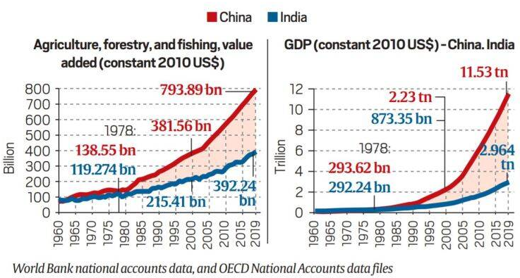
Problem Definition
Challenges in Indian Agriculture:
1. Inadequate Market Linkages
2. Market Price Fluctuations
3. Chronic Indebtedness
4. Limited Access to Knowledge 5. Lack of Crop Guidance
6. Lack of Adoption of Modern Technology

Slide 5
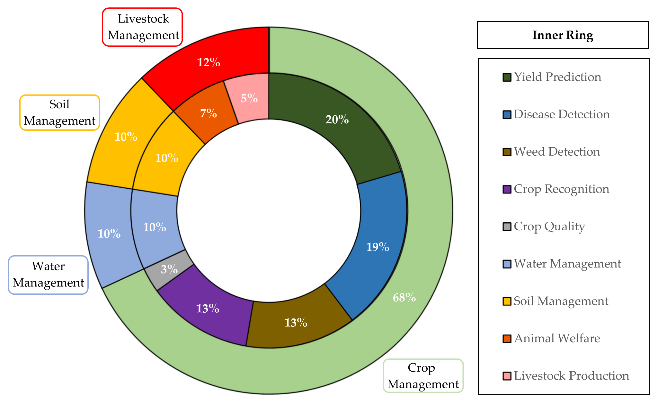
Goals
Leveraging the power of ML to help farmers wisely manage their crop production.
Using time-series models in order to predict market prices for the farmers.

Slide 6
Literature Survey
PAPER | DESCRIPTION
Crop Yield Prediction Using Machine Learning Algorithm - R. J, V. K. G. Kalaiselvi, A. Sheela, D. S. D and J. G. (2021) | This paper investigated Crop Yield Prediction Using Machine Learning Algorithm, achieving accuracies such as 82.00% for Random Forest, 79.00% for Support Vector Regression, 81.00% for XGBoost, 78.00% for K-Nearest Neighbors, 77.00% for Decision Tree, and 82.30% for Stacked Regression.
Supervised Machine learning Approach for Crop Yield Prediction in Agriculture Sector - Y. J. N. Kumar, V. Spandana, V. S. Vaishnavi, K. Neha and V. G. R. R. Devi(2020) | The accuracies for yield prediction models varied across different studies.In this paper, a supervised machine learning approach is employed, reporting accuracies of 82.00% for Random Forest, 79.00% for Support Vector Regression, 78.00% for K-Nearest Neighbors, 76.00% for Decision Tree, and 75.00% for Linear Regression.

Slide 7
Literature Survey
PAPER | DESCRIPTION
AI-based Market Intelligence Systems for Farmer Collectives: A Case-study from India - Ronak Ladhar, Sourav Sharma, Srikant Tangirala (+14) - (2023) | This paper presents a case study of an AI-based market intelligence system that was developed to help a network of farmer cooperatives in India growing soybeans. It suggests the use of LSTM cells to predict price fluctuations.
Crop Suggestion using Data Mining Approaches — S. Salankar, A. Salankar, A. Sune, P. Suryavansh and H. Kumar (2021) | This research paper used data mining to enhance agricultural decision-making. With K-Nearest Neighbors achieving 87.23% accuracy, Support Vector Machines at 82.11%, and Decision Tree at 85%, these algorithms prove instrumental in suggesting optimal crops for cultivation. The precision of these models offers valuable insights, contributing significantly to the efficiency and productivity of agricultural practices.

Slide 8
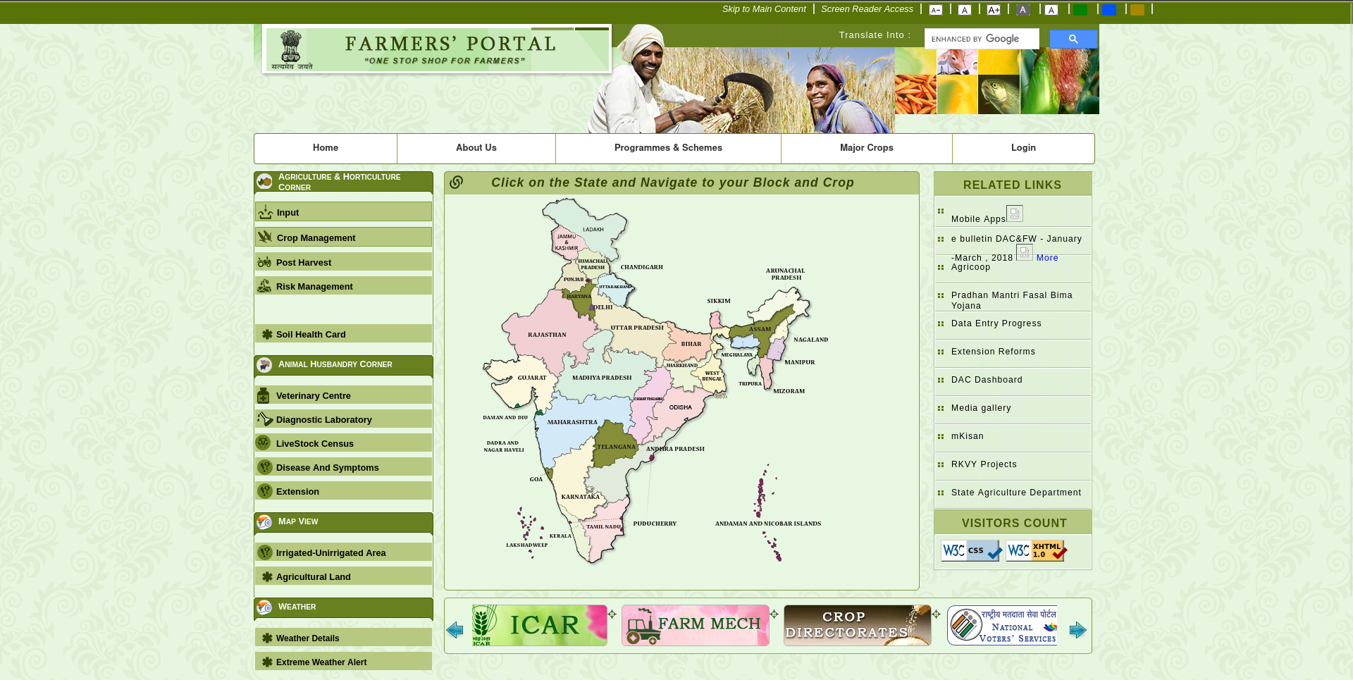
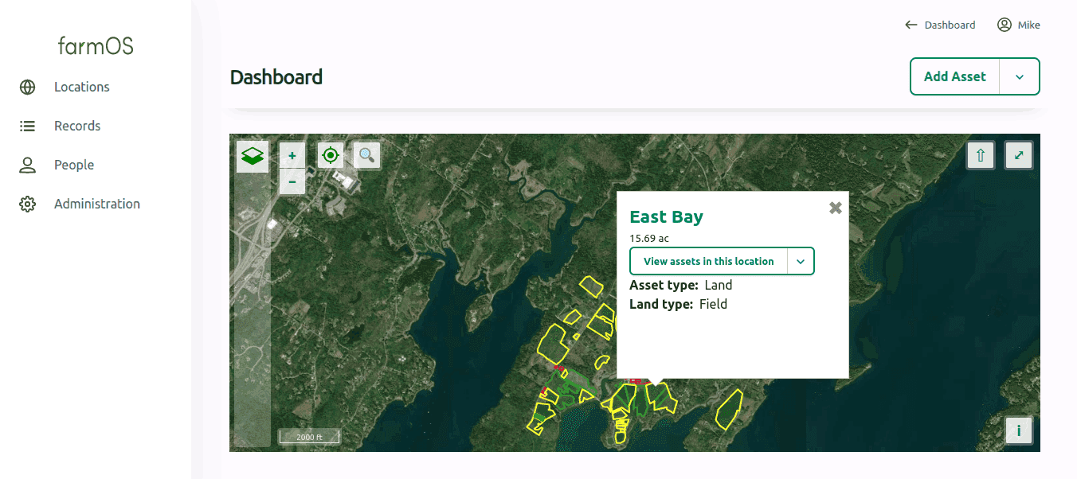
Limitation of Existing system or research gap
Some existing systems:
Government of India - Farmers’ Portal: https://farmer.gov.in/
FarmOS (US Based) https://farmos.org/

Slide 9
Limitation of Existing system or research gap
Non-existence of a combinational system for crop suggestion, Price prediction and recommendation of measures.
Fluctuation in the price of goods in Market places resulting in loss of farmer.
Absence of user Friendly UI for the use of Farmer who come from uneducated background.
No good indigenous solution like FarmOS.

Slide 10





Hardware, Software, Tools and constraint
Software:
Front-end:
Basic HTML, CSS/Sass, Vite for bundling SCSS
Back-end:
Python (flask)
Database:
MySQL
ML libraries used:
scikit-learn, tensorflow
Hardware:
A mobile device or PC

Slide 11

Proposed System
Interface for farmers
Prediction regarding fertility of the field,
yield, market prices, etc.
Crop cultivation recommendation
Cultivation strategy and sales
User (farmer) can make an account

Slide 12
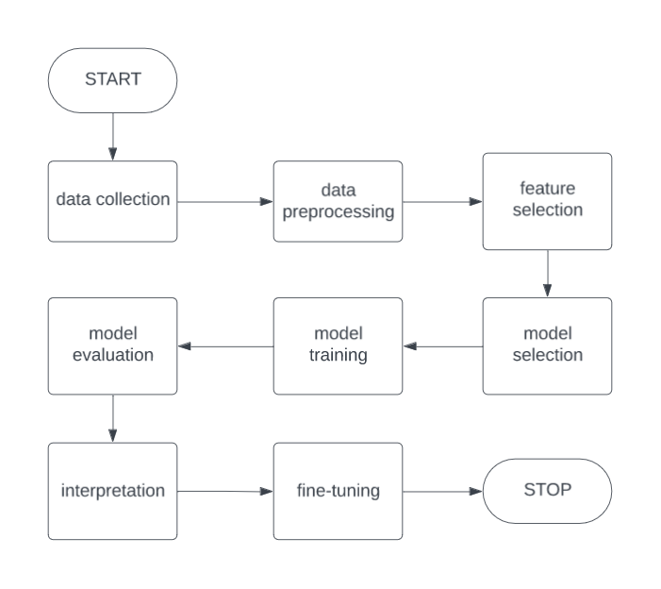
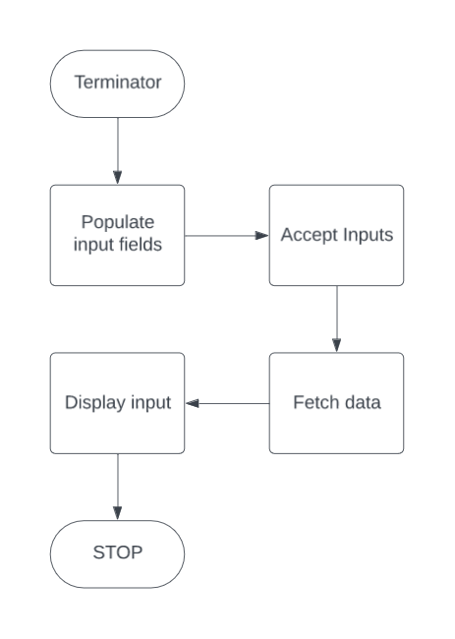
Architecture/ Framework (Block Diagram, Conceptual Diagram, ER Diagram)
Machine Learning Block Diagram
Front End Block Diagram
MORE ON THESE IN METHODOLOGY!

Slide 13
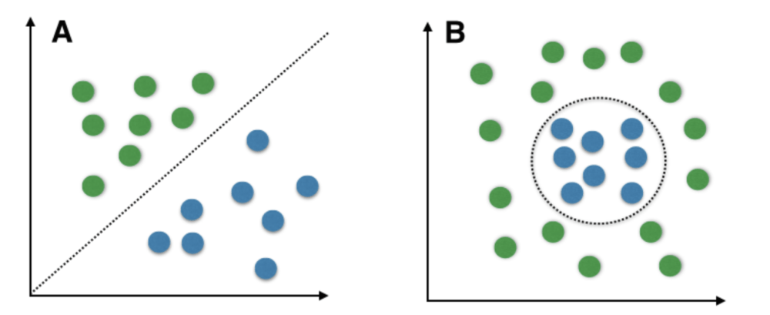
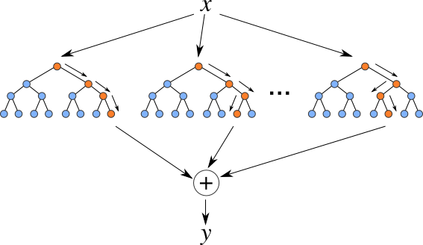
Methodology: Algorithm and Process Design
1. Data Collection (kaggle)
2. Data Preprocessing -
Removal of irrelevant data
3. Feature Selection -
crop recommendation:
N:P:K ratio,
temperature, humidity, pH rainfall
yield prediction: name of the crop, average rainfall (mm/year), tons of pesticides used, temperature
Random Forest (Ensemble Learning)

Slide 14
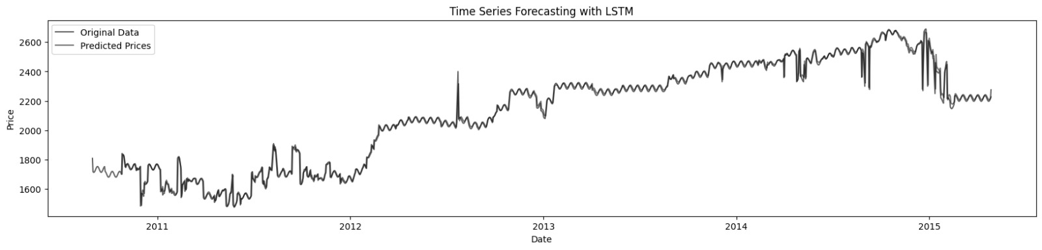
Methodology: Algorithm and Process Design
4. Model Selection - SVM - works well in multi-dimensional spaces (6 features in our case) - only con is noise vulnerability but data is clean
Random Forest Regressor - better for handling non-linear relations between data - less prone to overfitting
- less prone to noise
LSTM
-Handles Variable-Length Sequences
-Effective for Sequences
5. Model Training - persistent models with sklearn
6. Model Evaluation
7. Interpretation
8. Fine-tuning

Slide 15
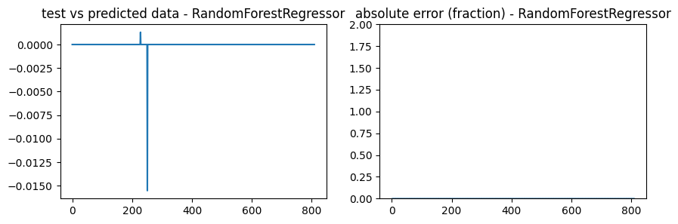
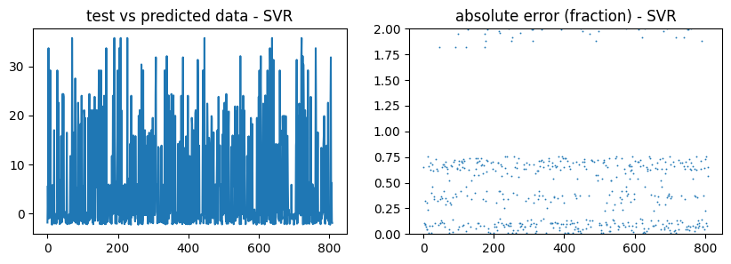
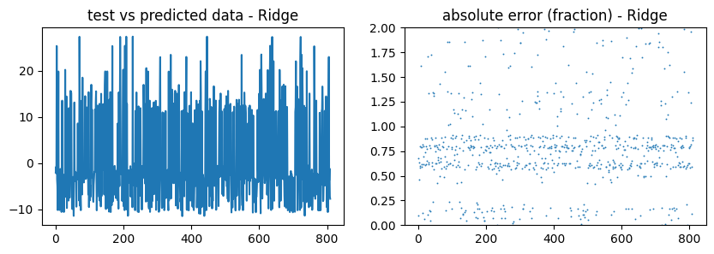
Methodology: Algorithm and Process Design
Drastic difference between evaluated models!

Slide 16
Methodology: Algorithm and Process Design
FRONT END
Population Populate the page with inputs and options as per the selected features. Load sample dataset.
Input Wait for user input. Alternatively, autofill the input if commanded.
Fetch On form submission fetch data from the backend in the form of a prediction.
Display Show the prediction to the user.

Slide 17
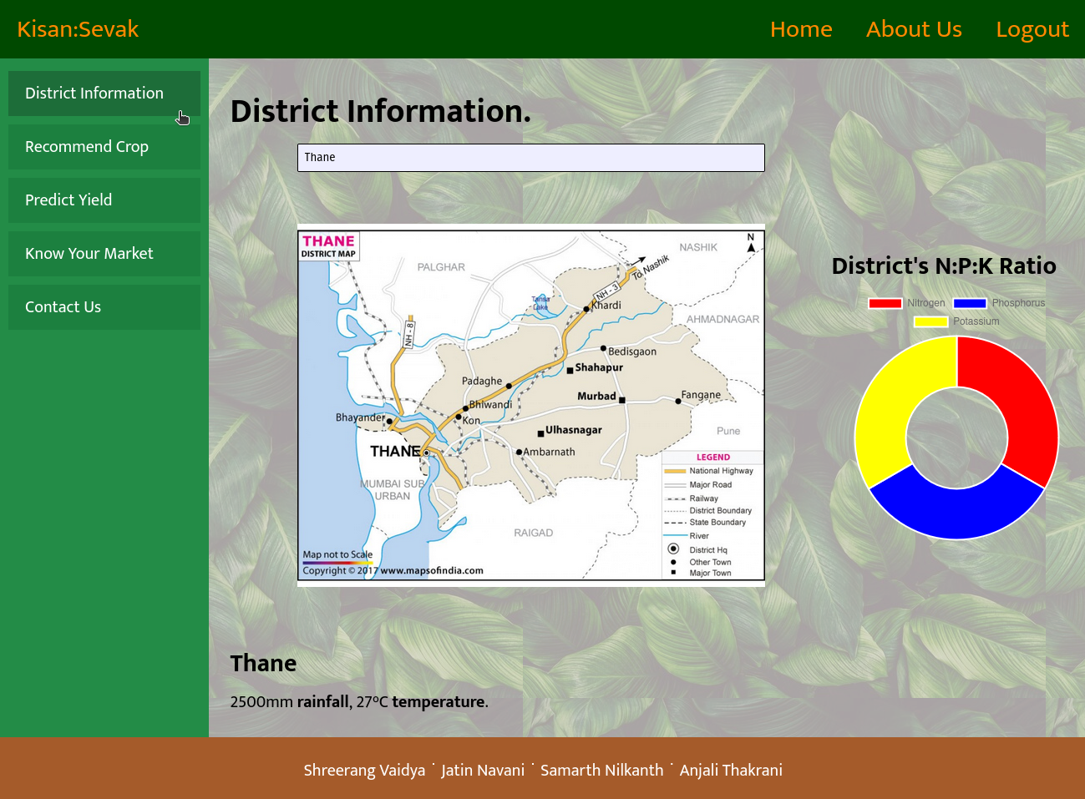
Implementation details(GUI Screenshot, Dataset Used)

Slide 18
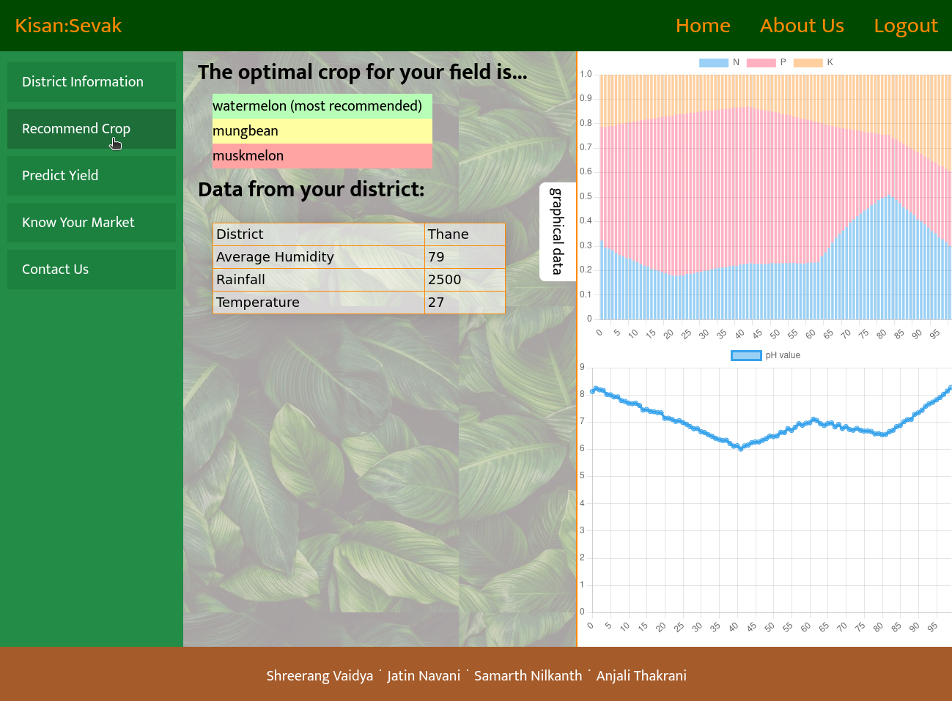
Implementation details(GUI Screenshot, Dataset Used)
Landing page
Crop Recommendation

Slide 19
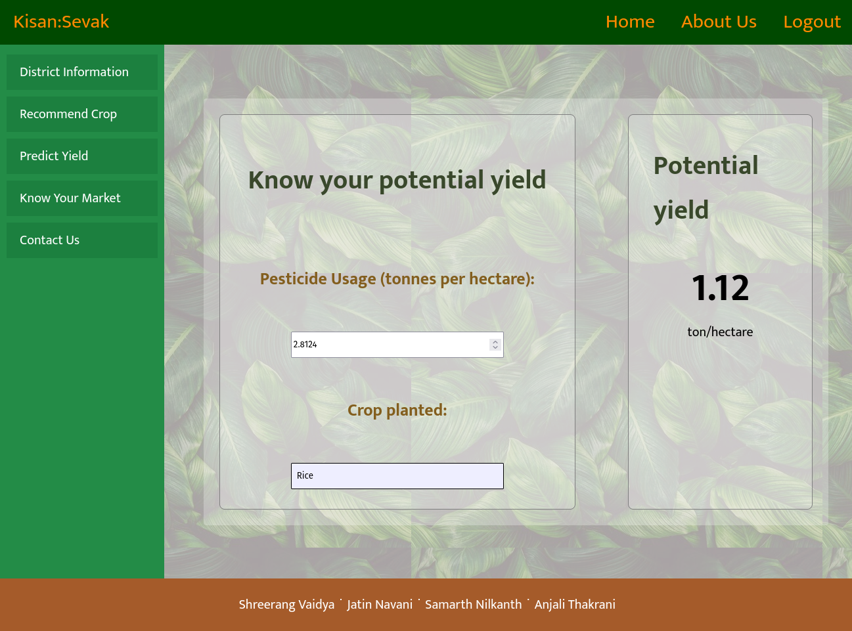
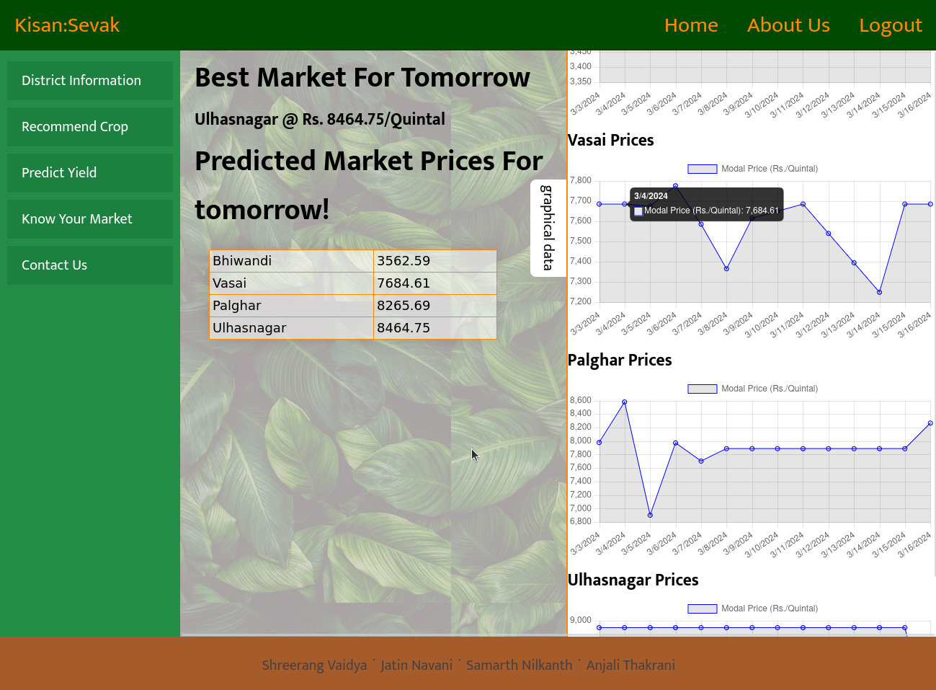
Implementation details(GUI Screenshot, Dataset Used)
Yield prediction
Market price prediction

Slide 20

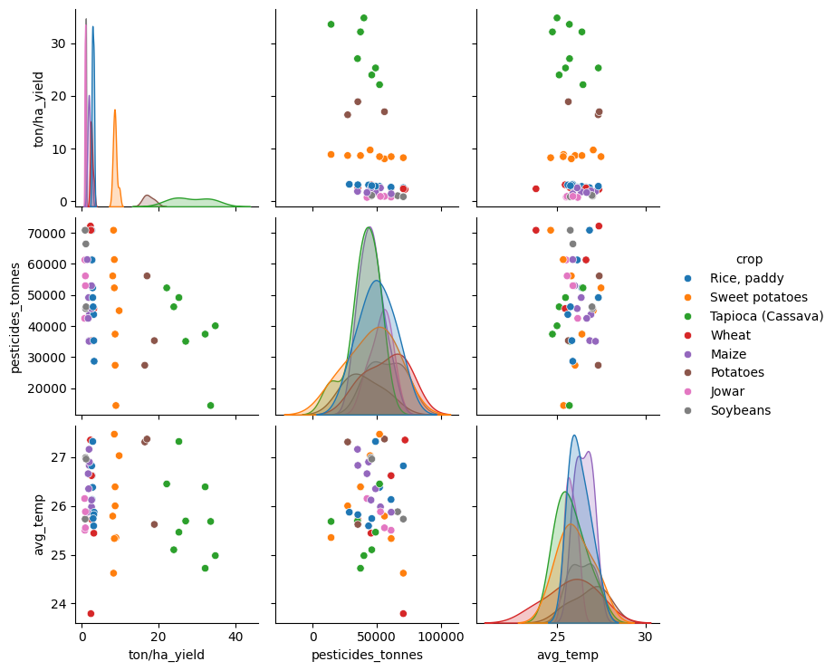
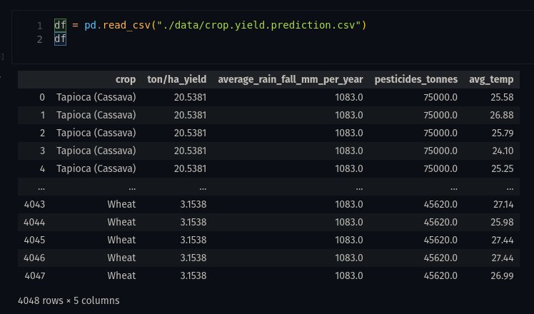
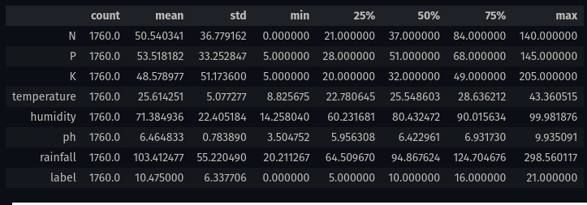
Implementation details (GUI Screenshot, Dataset Used)

Slide 21
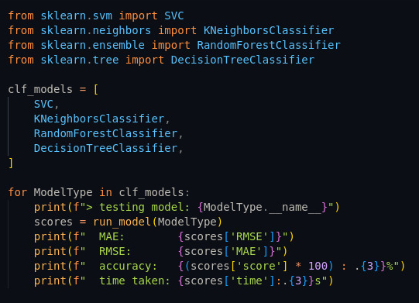
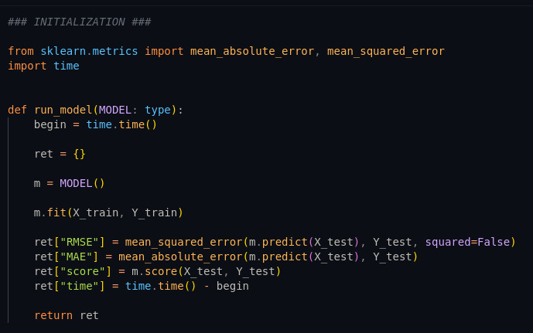
MODEL SELECTION

Slide 22
DATASETS
Datasets | Links
Crop Yield Prediction Dataset Predicting crop yield of 10 most consumed crops | https://www.kaggle.com/datasets/patelris/crop-yield-prediction-dataset?select=yield_df.csv
Crop Recommendation Dataset Maximize agricultural yield by recommending appropriate crops | https://www.kaggle.com/datasets/atharvaingle/crop-recommendation-dataset
Crop and Fertilizer Dataset for Western Maharashtra District-Wise Dataset | https://www.kaggle.com/datasets/sanchitagholap/crop-and-fertilizer-dataset-for-westernmaharashtra
AgMarknet - Collection of market databases | https://agmarknet.gov.in/

Slide 23
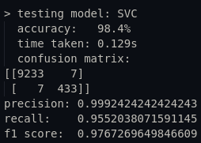
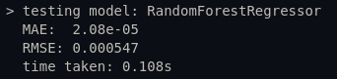
Results Obtained
Results obtained:
Error of regression model (RMSE): 5.47 x 10⁻⁴ ton/hectare
F1 score of classification model: 97.76%
(more about this in evaluation measures)
Social impact:
Proposed digital platform transforms Indian agriculture challenges.
Empowers farmers with technology and knowledge.
Aims to break chronic indebtedness and improve practices.
Benefits both farmers and the broader agricultural sector.

Slide 24
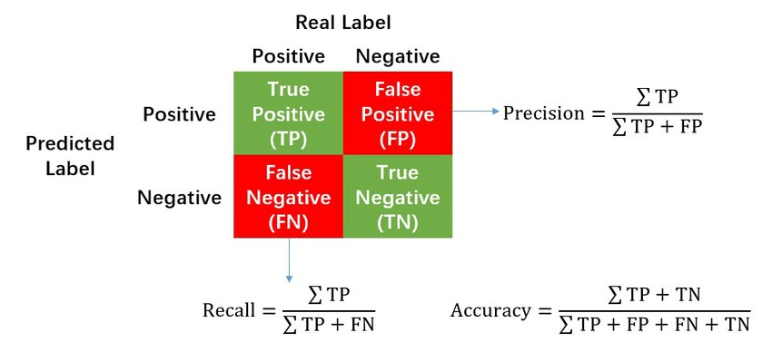
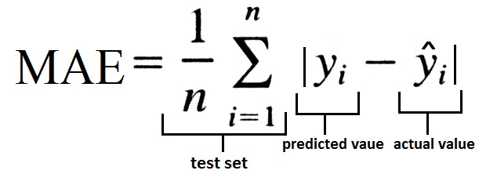
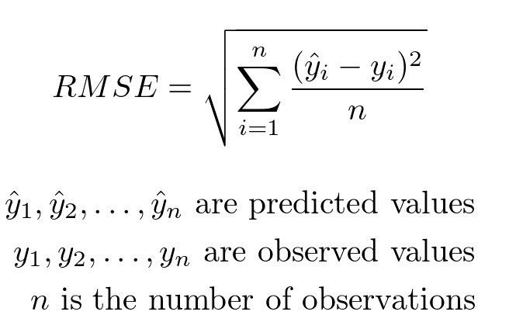
Evaluation Measures
Mean Absolute Error (MAE)
Root Mean Squared Error (RMSE)
Precision, Recall, and F1-Score

Slide 25
Conclusion and Future Scope
Local solution achieved with local database.
Transformation through advanced technology.
Empowerment with decision tools and knowledge.
FUTURE SCOPE
Better GUI.
Localization by adding local language support.
User Login Setup.

Slide 26
References
https://www.pib.gov.in/PressReleasePage.aspx?PRID=1741942
A. Shah, R. Agarwal and B. Baranidharan, ”Crop Yield Prediction Using Remote Sensing and Meteorological Data,” 2021 International Conference on Artificial Intelligence and Smart Systems (ICAIS), Coimbatore, India, 2021, pp. 952-960, doi: 10.1109/ICAIS50930.2021.9395849.
Ronak Ladhar, Sourav Sharma, Srikant Tangirala, Nishant Gupta, Abdul Azeem, Arjav Jain, Bhuvan Chand Katakam, Aditya Bommakanti, C. Sankaraiah, Hari Prasad Piridi, Kaushalendra Yadav, Kumra Vittalrao, Matiur Rahman, Rashul Chutani, Rishi Shah, Rohan Katepallewar, Dipanjan Chakraborty, and Aaditeshwar Seth. 2023. AI-based Market Intelligence Systems for Farmer Collectives: A Case Study from India. ACM J. Comput. Sustain. Soc. 1, 1, Article 6 (September 2023), 32 pages. https://doi.org/10.1145/3609262
Mupangwa, W., Chipindu, L., Nyagumbo, I. et al. Evaluating machine learning algorithms for predicting maize yield under conservation agriculture in Eastern and Southern Africa. SN Appl. Sci. 2, 952 (2020). https://doi.org/10.1007/s42452-020-2711-6
K. M P and D. N R, ”Crop Prediction Based on Influencing Parameters for Different States in India- The Data Mining Approach,” 2021 5th International Conference on Intelligent Computing and Control Systems (ICICCS), Madurai, India, 2021, pp. 1785-1791, doi: 10.1109/ICICCS51141.2021.9432247.
Y. J. N. Kumar, V. Spandana, V. S. Vaishnavi, K. Neha, and V. G. R. R. Devi, ”Supervised Machine Learning Approach for Crop Yield Prediction in Agriculture Sector,” 2020 5th International Conference on Communication and Electronics Systems (ICCES), Coimbatore, India, 2020, pp. 736-741, doi: 10.1109/ICCES48766.2020.9137868
Willoughby, C.M., Topp, C.F., Hallett, P.D. et al. Soil health metrics reflect yields in long-term cropping system experiments. Agron. Sustain. Dev. 43, 65 (2023). https://doi.org/10.1007/s13593-023-00919-3
D. Zhang, S. Chen, L. Liwen and Q. Xia, ”Forecasting Agricultural Commodity Prices Using Model Selection Framework With Time Series Features and Forecast Horizons,” in IEEE Access, vol. 8, pp. 28197- 28209, 2020, doi: 10.1109/ACCESS.2020.2971591.

Slide 27
References
Kurumatani, K. Time series forecasting of agricultural product prices based on recurrent neural networks and its evaluation method. SN Appl. Sci. 2, 1434(2020). https://doi.org/10.1007/s42452-020-03225-9
Ladhar, Sourav Sharma, Srikant Tangirala, Nishant Gupta, Abdul Azeem, Arjav Jain, Bhuvan Chand Katakam, Aditya Bommakanti, C. Sankaraiah, Hari Prasad Piridi, Kaushalendra Yadav, Kumra Vittalrao, Matiur Rahman, Rashul Chutani, Rishi Shah, Rohan Katepallewar, Dipanjan Chakraborty, and Aaditeshwar Seth. 2023. AI-based Market Intelligence Systems for Farmer Collectives: A Case Study from India. ACM J. Comput. Sustain. Soc. 1, 1, Article 6 (September 2023), 32 pages. https://doi.org/10.1145/3609262
S. Salankar, A. Salankar, A. Sune, P. Suryavansh and H. Kumar, ”Crop Suggestion using Data Mining Approaches,” 2021 12th International Conference on Computing Communication and Networking Technologies (ICCCNT), Kharagpur, India, 2021, pp. 1-5, doi: 10.1109/ICCCNT51525.2021.9579
R. Varun Prakash, M. Mohamed Abrith and S. Pandiyarajan, ”Machine Learning Based Crop Suggestion System,” 2022 6th International Conference on Intelligent Computing and Control Systems (ICICCS), Madurai, India, 2022, pp. 1355-1359, doi: 10.1109/ICICCS53718.2022.9788314.
P. A, S. Chakraborty, A. Kumar and O. R. Pooniwala, ”Intelligent Crop Recommendation System using Machine Learning,” 2021 5th International Conference on Computing Methodologies and Communication (ICCMC), Erode, India, 2021, pp. 843-848, doi: 10.1109/ICCMC51019.2021.9418375.
D. Modi, A. V. Sutagundar, V. Yalavigi and A. Aravatagimath, ”Crop Recommendation Using Machine Learning Algorithm,” 2021 5th International Conference on Information Systems and Computer Networks (ISCON), Mathura, India, 2021, pp. 1-5, doi:
10.1109/ISCON52037.2021.9702392.

Slide 28
References
Z. Doshi, S. Nadkarni, R. Agrawal and N. Shah, ”AgroConsultant: Intelligent Crop Recommendation System Using Machine Learning Algorithms,” 2018 Fourth International Conference on Computing Communication Control and Automation (ICCUBEA), Pune, India, 2018, pp. 1-6, doi: 10.1109/ICCUBEA.2018.8697349.
R. J, V. K. G. Kalaiselvi, A. Sheela, D. S. D and J. G, ”Crop Yield Prediction Using Machine Learning Algorithm,” 2021 4th International Conference on Computing and Communications Technologies (ICCCT), Chennai, India, 2021, pp. 611-616, doi: 10.1109/ICCCT53315.2021.9711853.
D. Elavarasan and P. M. D. Vincent, ”Crop Yield Prediction Using Deep Reinforcement Learning Model for Sustainable Agrarian Applications,” in IEEE Access, vol. 8, pp. 86886-86901, 2020, doi: 10.1109/ACCESS.2020.2992480.
M. Singh Boori, K. Choudhary, R. Paringer, A. Kupriyanov and Y. Kim, ”Wheat Yield Estimation and Prediction Via Machine Learning,” 2023 IX International Conference on Information Technology and Nanotechnology (ITNT), Samara, Russian Federation, 2023, pp. 1-4, doi: 10.1109/ITNT57377.2023.10139117

